Slide 1
ODK Aggregate To ODK Central Migration
Analysis Document
Submitted To : CAG

Slide 2
Objective

Slide 3
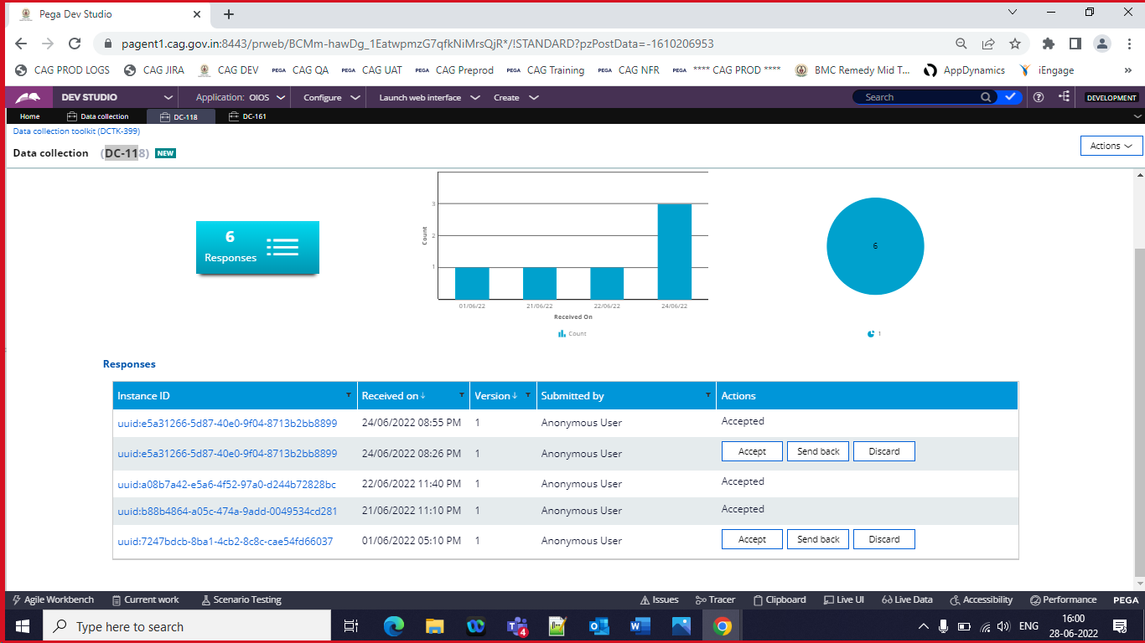
Viewing responses in Pega ODK Aggregate which publish all the submitted responses dynamically back to PEGA through the messaging queue . However ODK Central lacks this feature and demands all publishing through new introduced ODATA only.
Hence , Switching to ODK Central might lead to lack of view responses feature in PEGA

Slide 4
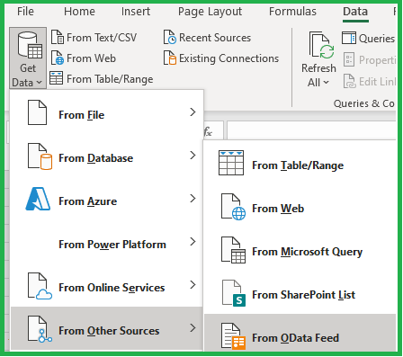
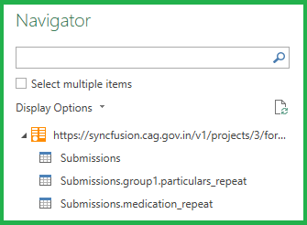
ODK Central Compatibility i) ODK Central connectivity with Excel : ODK Central connected to excel successfully through OData

Slide 5
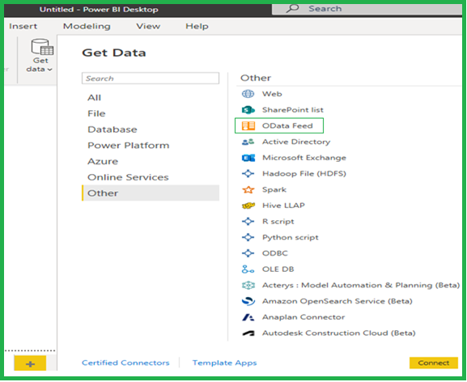
ii) ODK Central connectivity with Power BI : ODK Central connected to Power BI successfully through OData

Slide 6
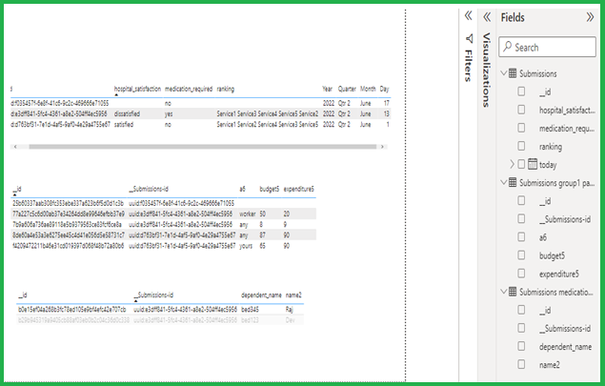
Responses data in Power BI

Slide 7
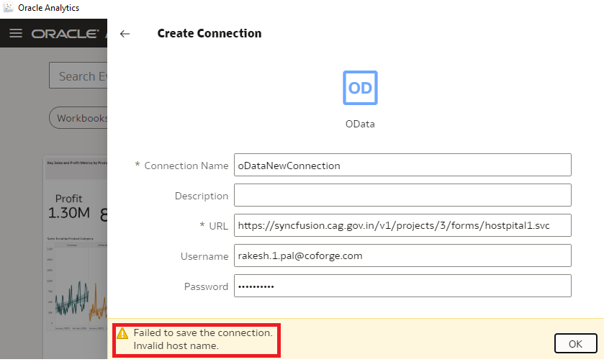
iii) ODK Central connectivity with OAS : ODK Central failed to connect with OAS

Slide 8
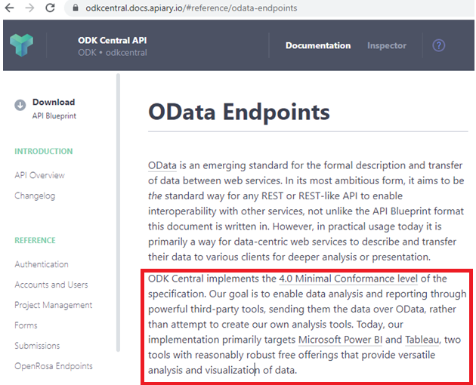
ODK Central reference docs discussing about compatibility of various BI tools

Slide 9
Database migration Although both ODK Aggregate and ODK Central uses Postgres database the core table structures of both ODK Central and ODK aggregate are different . Hence,it is recommended to uses fresh Postgres set up while switching to ODK Central where DCTK forms created earlier might not be functional. Redis Cache migration This cache stores the form url with which it maps to form id present in the database, migration would might lead to loss of this data . Hence not recommended. Application migration and its Integration with PEGA ODK aggregate is Java built in application whereas ODK central is .NodeJs built in . Hence , this is feasible but complete rework of integration work with .NodeJS resources only. IDAM integration ODK Central accepts both basic and Oauth authentication whereas IDAM does not accept basic authentication but accepts Oauth authentication. A thorough POC is required to verify if both systems are compatible to sync. with each other.

Slide 10
Impacted Areas i) View Responses in Pega : Since ODK Central unlike ODK Aggregate does not provide any feature of publishing data apart from OData , view response feature would not be available. ii) Publishing data to OAS : As per official ODK Central doc , the latest version supports excel ,Power BI and Tableu only. Hence , not compatible with the existing OAS. iii) DCTK form URL of existing form : The existing data collection forms might not open and submissions would not work with the existing URL .Only new created forms would be compatible with the new generated URL. iv) Form Preview : Form preview would not be available of the existing (ODK aggregate) DCTK form after this migration, although newly generated in ODK central would work. v) Rework : Complete rework (i.e. NodeJS development) of all the customisation is required for ODK central integration with PEGA.

Slide 11
Conclusion Based upon the above impacted areas , switching to ODK Central is not recommended . If the sole objective of this migration /switching is only to get survey response data in OAS, it should be performed by alternate methods. One of the alternate method with minimal efforts already exist in the application is downloading the DCTK responses in PEGA and uploading the same in OAS.

